Slide 1

Investor Presentation
March 17, 2021

Slide 2
Safe Harbor Statement
This presentation by Eastside Distilling, Inc. (the “Company,” “we,” “us,” and “our”) includes “forward-looking statements” within the meaning of the Private Securities Litigation Reform Act of 1995, Section 27A of the Securities Act of 1933, as amended, and Section 21E of the Securities Exchange Act of 1934, as amended. All forward-looking statements are subject to a number of risks, uncertainties and assumptions, and you should not rely upon forward-looking statements as predictions of future events. You can identify forward-looking statements by words such as “anticipate,” “believe,” “could,” “estimate,” “expect,” “intend,” “may,” “plan,” “potential,” “predict,” “project,” “should,” “would,” “will,” “target,” “contemplates,” “continue” or the negative of those words or other similar terms or expressions that concern our expectations, strategy, plans, or intentions. These statements are based on management’s current expectations and/or beliefs and assumptions about future events and trends that management considers reasonable, which assumptions may or may not prove correct. We may not actually achieve the plans, carry out the intentions or meet the expectations disclosed in the forward-looking statements and you should not place undue reliance on these forward-looking statements. Moreover, we operate in a very competitive and rapidly changing environment. New risks and uncertainties emerge from time to time, and it is not possible for us to predict all risks and uncertainties that could have an impact on the forward-looking statements. Actual results and performance could differ materially from those projected in the forward-looking statements as a result of many factors. Some of the key factors that could cause actual results to differ materially from those expressed or implied in the forward-looking statements include, but are not limited to, the effect and consequences of the novel coronavirus (“COVID 19”) public health crisis on matters including U.S. and local economies, our business operations and continuity, the availability of corporate financing, the health and productivity of our associates, the ability of third-party providers to continue uninterrupted service, and the regulatory environment in which we operate; our ability to sustain recent growth rates in portions of our business; our ability to restructure operations and achieve profitability; our ability to manage the growth of our operations over time; our ability to maintain, grow and enforce our brand and trademark rights; our ability to improve our products and develop new products; our ability to execute on and realize the benefits of our strategic priorities; our ability to obtain, grow and enforce intellectual property related to our business and avoid infringement or other violation of the intellectual property rights of others; our ability to successfully expand operations; and our ability to compete and succeed in a highly competitive and evolving industry, as well as those risks and uncertainties disclosed under the sections entitled “Risk Factors” and “Management’s Discussion and Analysis of Financial Condition and Results of Operations” in our most recent Annual Report on Form 10-K and Quarterly Report on Form 10-Q filed with the Securities and Exchange Commission (“SEC”), and similar disclosures in subsequent reports filed with the SEC, which are available on our investor relations website at eastsidedistilling.com/investors and on the SEC website at www.sec.gov. The forward-looking statements made in this presentation relate only to events as of the date on which the statements are made. We undertake no obligations to update any forward-looking statements made in this presentation to reflect events or circumstances after the date of this presentation or to reflect new information or the occurrence of unanticipated events, except as required by law. Certain data in this presentation was obtained from various external sources. Neither the Company nor its affiliates, advisers or representatives have verified such data with independent sources. Accordingly, neither the Company nor any of its affiliates, advisers or representatives make any representations as to the accuracy or completeness of that data or to update such data after the date of this presentation. Such data involves risks and uncertainties and is subject to change based on various factors. Use of Non-GAAP Information This presentation includes certain non-GAAP financial measures that are supplemental measures of financial performance not required by, or presented in accordance with, GAAP, including Adjusted EBITDA. We define “Adjusted EBITDA” as earnings before interest, taxes, depreciation and amortization, adjusted for the impact of certain non-cash and other items that we do not consider in our evaluation of ongoing operating performance. These items include professional fees, equity-based compensation expense, write-offs of property and equipment, deferred rent, financing expenses and certain other charges and gains that we do not believe reflect our underlying business performance. We have also presented herein certain forward-looking statements about the Company’s future financial performance that include non-GAAP (or “as-adjusted”) financial measures, including Adjusted EBITDA. This non–GAAP financial measure is derived by excluding certain amounts, expenses or income, from the corresponding financial measures determined in accordance with GAAP. The determination of the amounts that are excluded from this non-GAAP financial measure is a matter of management judgment and depends upon, among other factors, the nature of the underlying expense or income amounts recognized in a given period. We are unable to present a quantitative reconciliation of the aforementioned forward-looking non-GAAP financial measure to its most directly comparable forward-looking GAAP financial measures because management cannot reliably predict all of the necessary components of such GAAP measures, which could be significant in amount. We believe that these non-GAAP financial measures not only provide its management with comparable financial data for internal financial analysis but also provide meaningful supplemental information to investors. However, other companies in our industry may calculate these items differently than we do. These non-GAAP measures should not be considered as a substitute for the most directly comparable financial measures prepared in accordance with GAAP, such as net income (loss) or net income (loss) per share as a measure of financial performance, cash flows from operating activities as a measure of liquidity, or any other performance measure derived in accordance with GAAP.
Notes:
Reference Safe Harbor Statement

Slide 3


Why Invest in Eastside?
Professionalized
Platform
For Rapid Growth
Diversified
Portfolio with
Craft Canning
Craft Spirits
Category
CAGR 33%
INVESTMENT
HIGHLIGHTS
Experienced
Management with
Successful Track
Record
Very Cool Spirits Brands
& Products Uniquely
Positioned for Growth
Focused
Strategy for
Proficiency
Notes:
PURPOSE: Summarize Investment Highlights—introduce “Why invest in Eastside”
FIRST STEPS - Over the past year Management has taken a number of important steps to rebuild the Eastside platform with the potential for sustained profitable growth
MARKET - Craft’s Spirit growth continues unabated despite the pandemic
PROFESSIONALIZE - We have professionalized the platform --priority in 2020
FOCUS theme of the turnaround - Strategy for 2021 and building 3 year plan
CANNING - Diversity of having Craft Canning alongside Spirits

Slide 4
Eastside Mission | Vision | Values
EASTSIDE DIFFERENTIATION: Craft Inspired but not Craft Constrained
MISSION
VISION
To move beyond conventional craft distillery constraints
To build a hybrid model of branding and manufacturing
To have an innovative approach to craft spirits with a national network
To build premiere, premium craft spirits brands that are approachable and desirable
To excel at authenticity, quality, taste and experience
We are a craft inspired spirits company focused on artisanal products, experiential brands and alcoholic beverage manufacturing excelling in branding, product innovation, barrel aging and supply chain
VALUES - Craftsmanship | Teamwork | Integrity | Performance

Slide 5
Spirits Growth and Craft Spirits Explosion
2020 to 2025 CAGR Total Spirits 6.02% and Craft Spirits 33.7%
Underlying Drivers of
US Spirits Category
Shift from Beer & Wine
Premiumization
New Products and RTD’s
Millennial Consumption
Whiskey, Tequila, Cognac
Underlying Drivers of
Craft Spirits
Authenticity
Higher Quality
Farm to Flask
Craftmanship
New Products with Flavors
Notes:
PURPOSE: Draw out the distinction between Spirits sector growth and Craft growth
Underlying driver of spirits growth are well known—shift to premiumization, specific spirits categories outperforming, aging demographic—new millennial consumption
However, less understood is the boom within Spirits—the craft Explosion. Look at what has happened in beer
Craft Spirits—authentic, quality, craftmanship, innovation

Slide 6
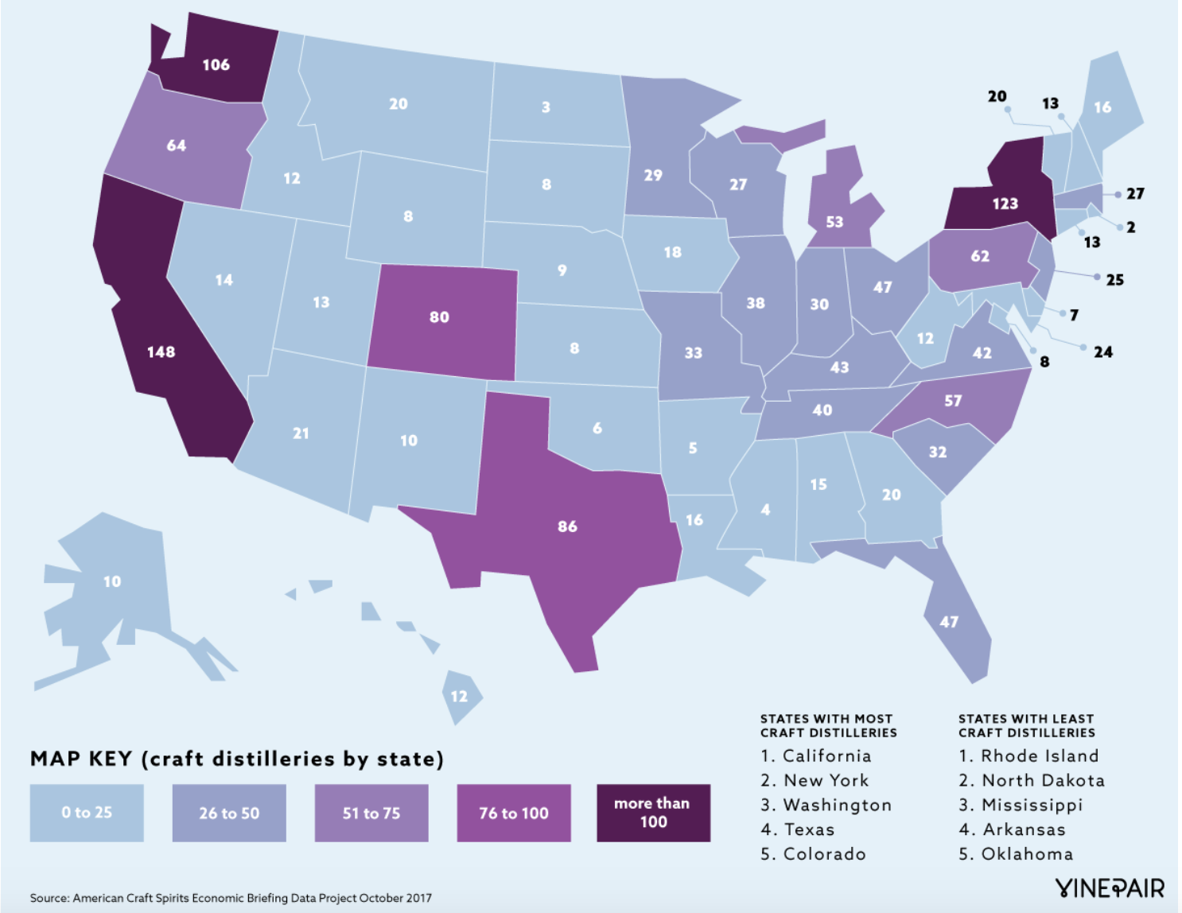
Top Craft Distilleries by States and CDI
Definition: "The CDI is a measure of the relative sales strength of a particular product category in a specific market area of the United States."
The percent of product category A's total U.S. sales in market X is divided by the percent of total U.S. population in market X, then multiplied by 100 to get the index number.

Slide 7
Strategic Opportunity for Craft Spirits
STRATEGIC FOCUS: WEST
16% population and 21% craft distilleries
Washington State
Oregon
California
STRATEGIC OPPORTUNITY: SOUTHWEST
10% US population 11% craft distilleries
Colorado
Texas
STRATEGIC OPPORTUNITY: NORTHEAST
10% US population 12% craft distilleries
New York
Pennsylvania

Slide 8
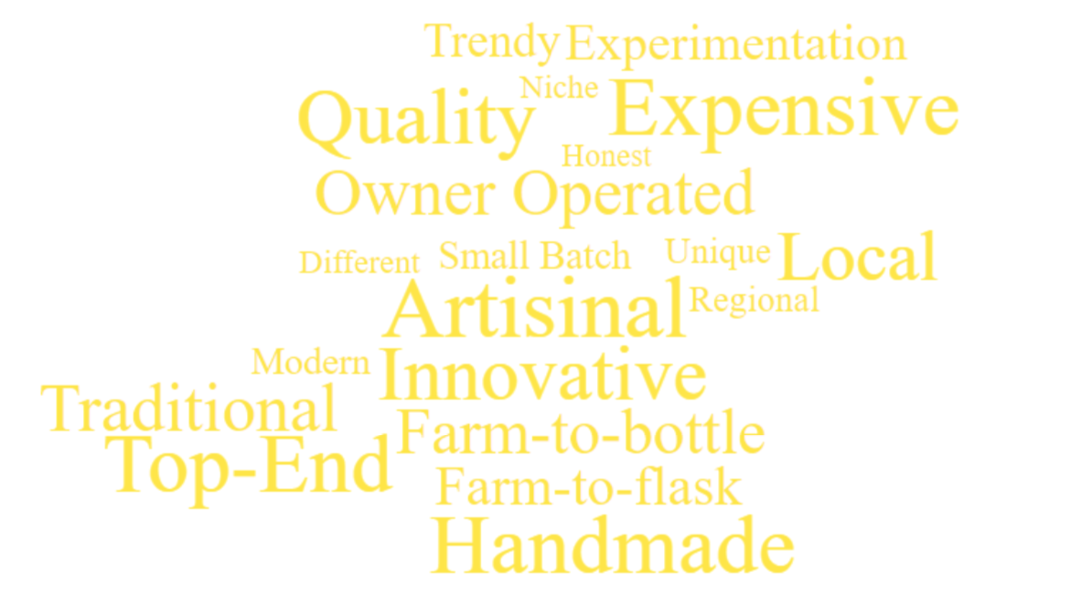
Underlying Drivers of Craft Spirits
Cocktail Renaissance
Led by millennials
Flavorful inspiration
Mirroring artisanal food
Coastal Focus
Intensifying “farm-to-flask”
Movement
Seeking authentic products
Artisanal attraction
Better ingredients & higher quality
Authentic production process
Better taste experience
Local experience & personal interaction
71% purchase based on company ethics
VALUES -
Growing “share-of-throat”
of Spirits V Beer
Consumption skewing younger
Interest in new & different flavors
Shift in usage occasion
Shift in perception – quality & premium

Slide 9
Turnaround Approach
STRATEGIC INTENT -
FIX
Controls
Margins
Working Capital
Balance Sheet
Cash Flow
BUILD
Board
Management
Platform
Budget
3-year Plan
Brands/Products
Strategy & Structure
Investment Capital
GROW
Brands
Margins
Distribution
Free Cash Flow
Focus West Model
Expand East Model

Slide 10



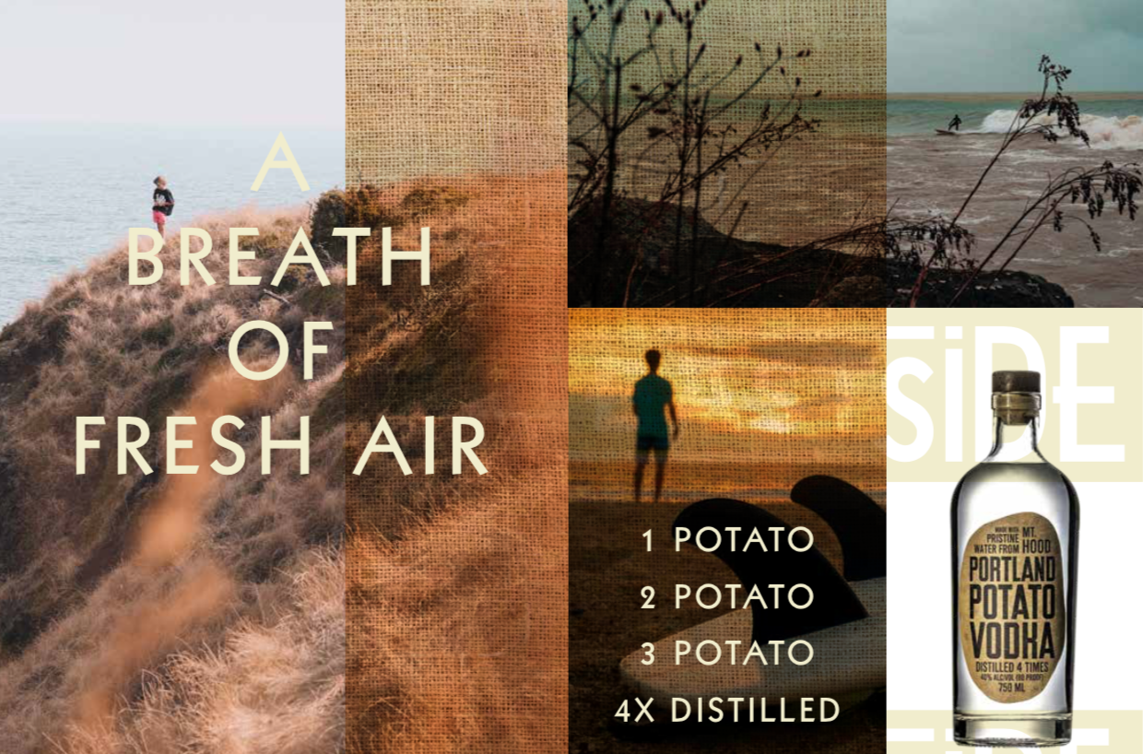
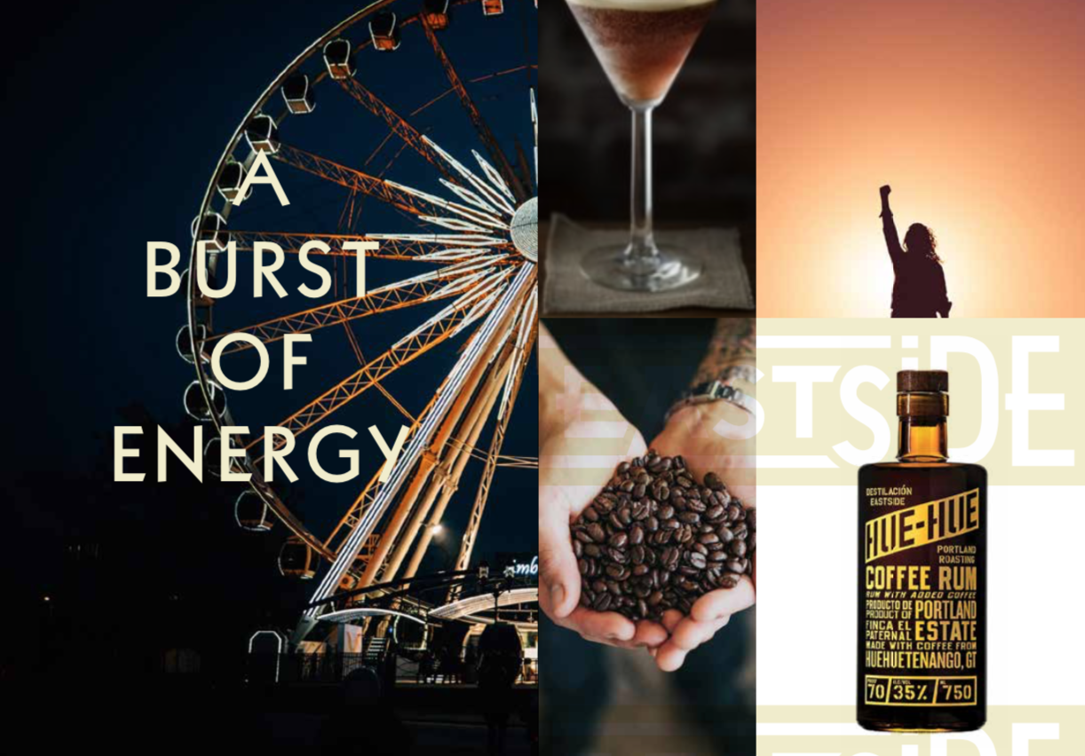
1 Brand Differentiation

Slide 11
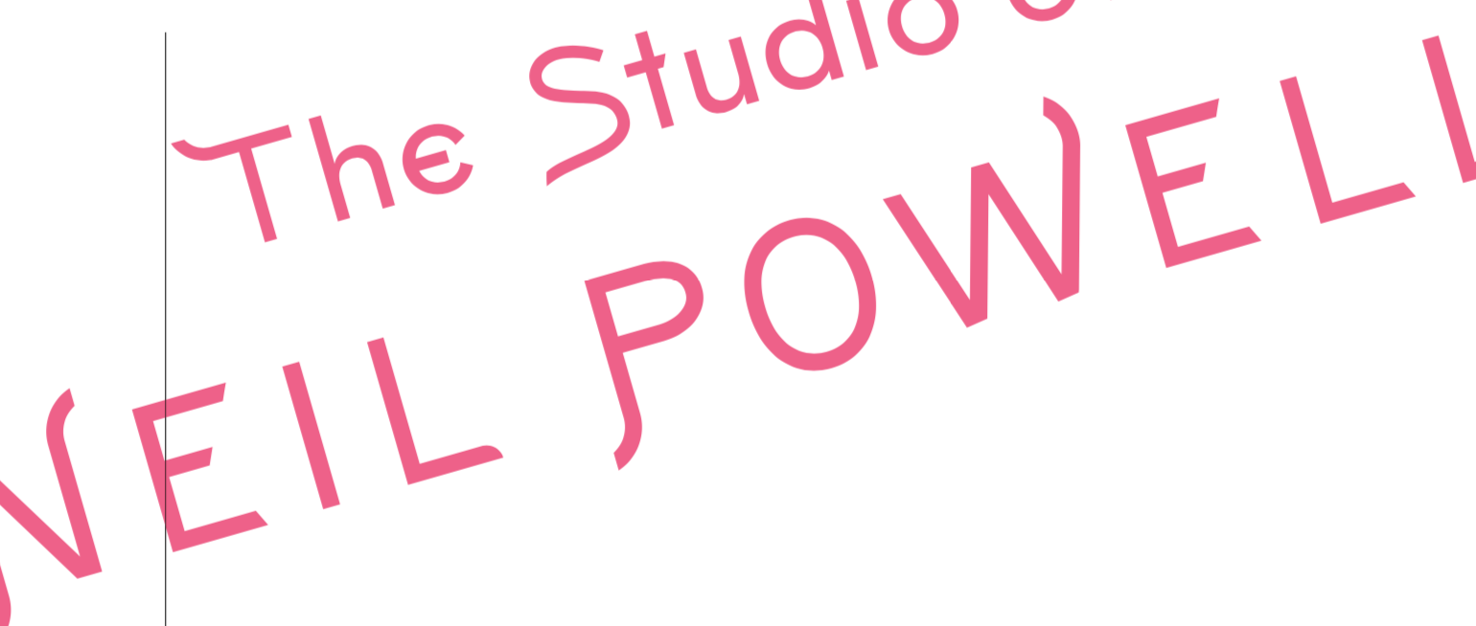
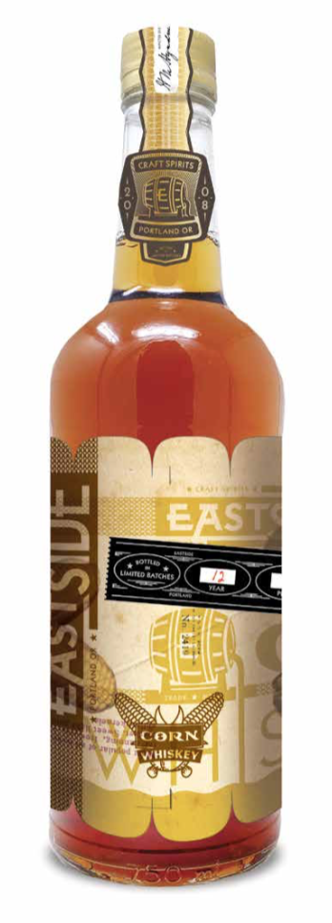
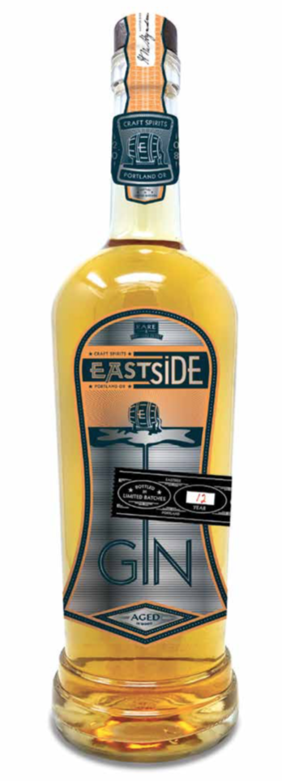
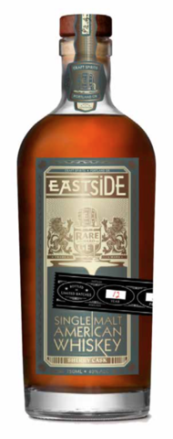
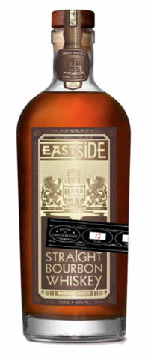
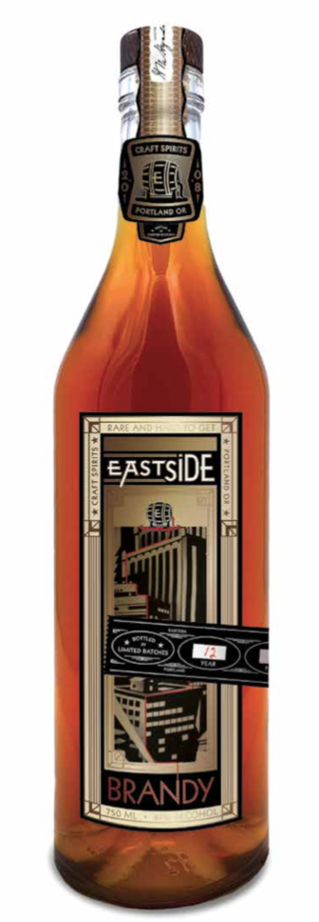
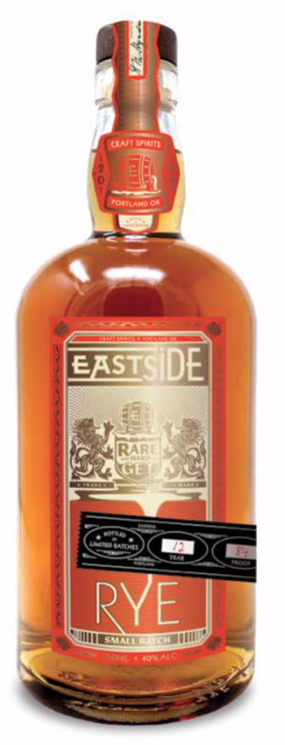
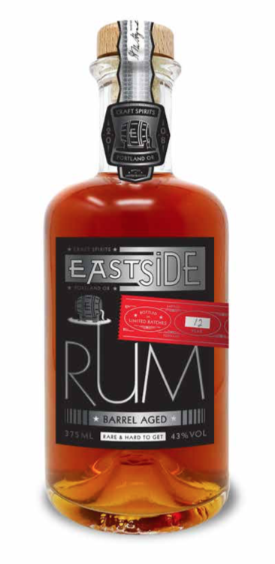
Product Innovation
2

Slide 12
Innovation drives Premiumization
Notes:
PURPOSE: We are targeting Craft and Premiumization
Over the past two years we invested in Redneck Rivieria—the low end of Spirits and far from craft; lost $26mm in 2018 and 2019
We have an opportunity to unlock valuable assets held in working capital AND push innovation with Premium Limited Edition Products
These will be launching now and impact Q2

Slide 13
Market Research Driven Branding
Notes:
PURPOSE: To show investment in branding driven by research
With the addition of industry executives including a Chief Branding Officer, the company drives branding decisions with market research
PPV is an example of this—new bottle, new focus on positioning and value proposition to the consumer
Initial results suggest strong success here—these learnings have led to key elements of our 2021 plan

Slide 14
Repositioning Legacy Brands
Notes:
PURPOSE: We are taking critical steps to reposition legacy brands
Legacy Brands were mismanaged, poor architecture and execution
Burnside is an example where we had a problem that inhibited growth, investment and margins
Repositioned to maximize margin and investment

Slide 15
Margins Drive Investment
Notes:
PURPOSE: Our focus is margin drives investment
In 2020 the company had to make key investments to rebuild its ability to assess successes and failure. One key investment was an investment in FP&A with a focus on the product portfolio
Azunia is an example of where the company made “blind” investments without fully understanding its margin opportunities
Margin driven investment is a core strategic priority for every decision in spirits

Slide 16
Realignment of Resources
Notes:
PURPOSE: Describe the re-alignment of resources
While in the past the company chased good ideas, now it follows fact based data to sustainable and predictable results
The company has re-aligned it resources across the company—sales, finance, production, and marketing to achieve best in-class growth and margins for a company our size

Slide 17
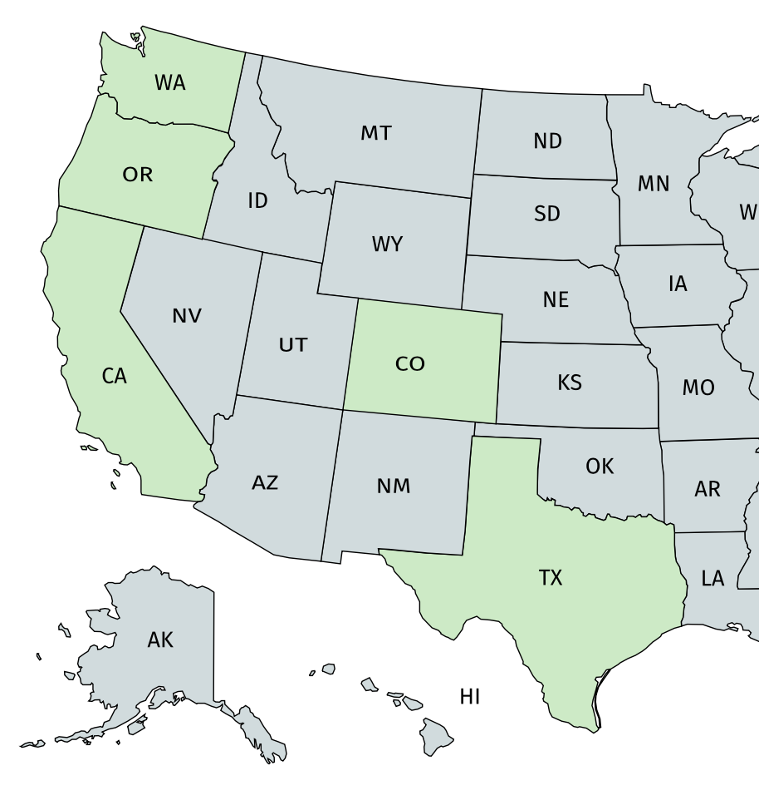
2021 Strategy: INVESTMENT 5 States with highest Craft Spirits/CDI
#3
#7
Invest and Grow in Five States
Oregon
California
Texas
Colorado
Washington
#1
#28
#5
#4
Top rank Craft Distillery States
*Data from statista.com
Notes:
PURPOSE: We have the right model and in the right place must stay “Focused”
Turns out Portland is hugely important
Oregon and the Pacific Northwest is more important than a “thin” National Foot Print
Oregon, California, Texas, Colorado and Washington are key states for the Craft “Explosion” In prior years we were racing to get east when the “gold mine” is in the west
Spirits will invest in these key states—focus innovation and product development there. If successful we will get “permission” and “invited” to go national as opposed to pay out all gross margin to go national

Slide 18






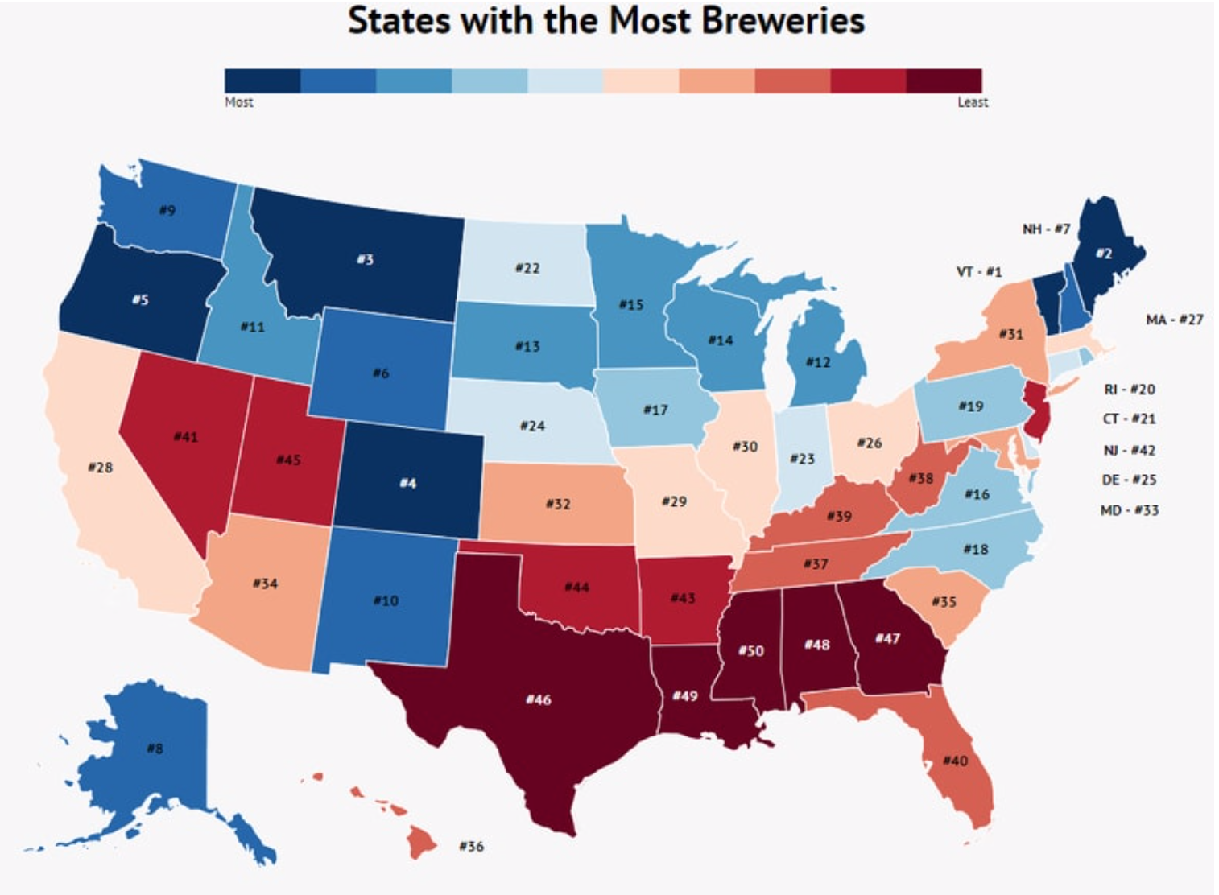


Contract Manufacturing
3
CRAFT Model
Regional expansion
Mobile/flexible
Can focus
Contract manufacturing
Beer, wine, cider, seltzer,
non-alcoholic, kombucha,
energy drinks CBD & RTD cocktails
Trucks/Lines 200-300 CPM
CRAFT Method
Center of operational excellence for Eastside
Target Small facilities with limited space
Expand via M&A, Contract Canning/Bottling
Black Belt principles
Statista defined a craft brewery as any brewery that makes under 6 million barrels of beer a year and isn’t majority-owned by another big alcohol company. From there, the craft brewery must have a Brewer’s Notice from the Alcohol and Tobacco Tax and Trade

Slide 19
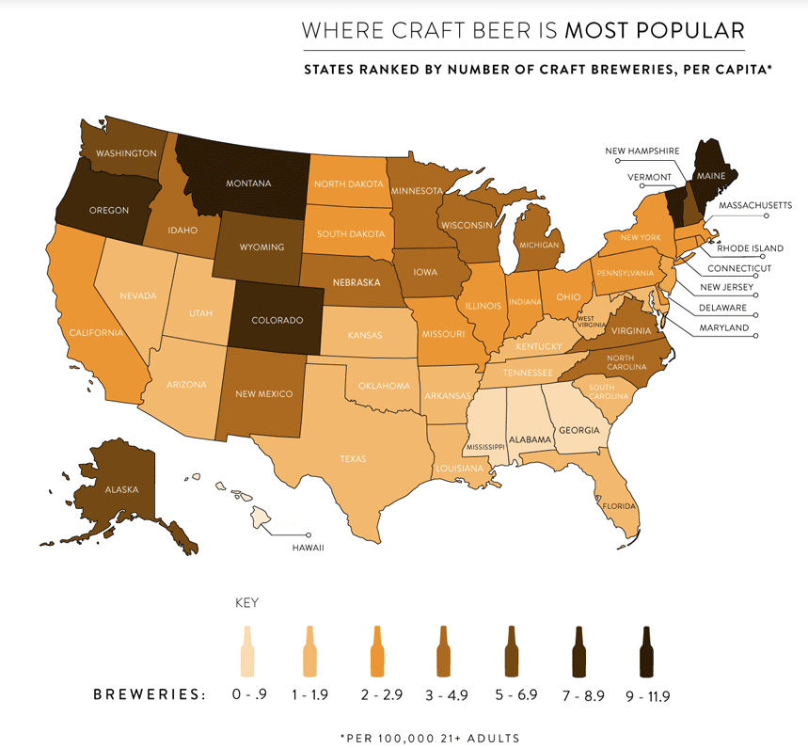
Craft Canning + Bottling Market Opportunity
Pacific Northwest Mobile Canning Growth driven by concentrated growth of regional brewers
The number of microbreweries have grown mid-double digits over the past 5 years(1)
Craft Canning has focused operations in three of the top 10 states experiencing the “Craft Beer Revolution” Oregon (#6), Washington (#9) and Colorado (#4) (1)(2)
(1) C+R Research: https://www.visualcapitalist.com/numbers-craft-beer-industry-u-s/c
(2) Brewers Association: https://www.brewersassociation.org/statistics-and-data/state-craft-beer-stats/?state=WA
Notes:
PURPOSE: Craft has critical scale in the Pacific Northwest on top of great market
Turns out Portland is hugely important for Craft Beverage too
Mobile canning following growth of microbreweries, wineries, and cider
Mobile canning opportunity is not like large scale contract manufacturing—value proposition to customer completely different—we are critical to them and they pay for it

Slide 20
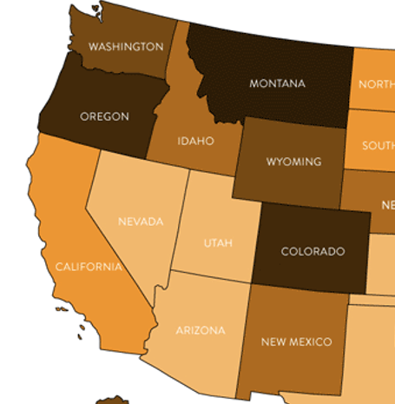
Craft Canning Expansion Strategy
Expand through hub-spoke model to capture demand
Leverage customer base and size of opportunity with higher margin services
2019 Data from Brewers Association: www.brewersassociation.org
Notes:
PURPOSE: Craft strategy has a high return on investment
Craft’s utilization rate is highly correlated with margins—100% utilization = very high margins
Hub and Spoke expands utilization lowers investment raises barriers to entry
Cash margins and low capital costs help support Spirits growth
Synergies to be realized between Spirits and Canning

Slide 21
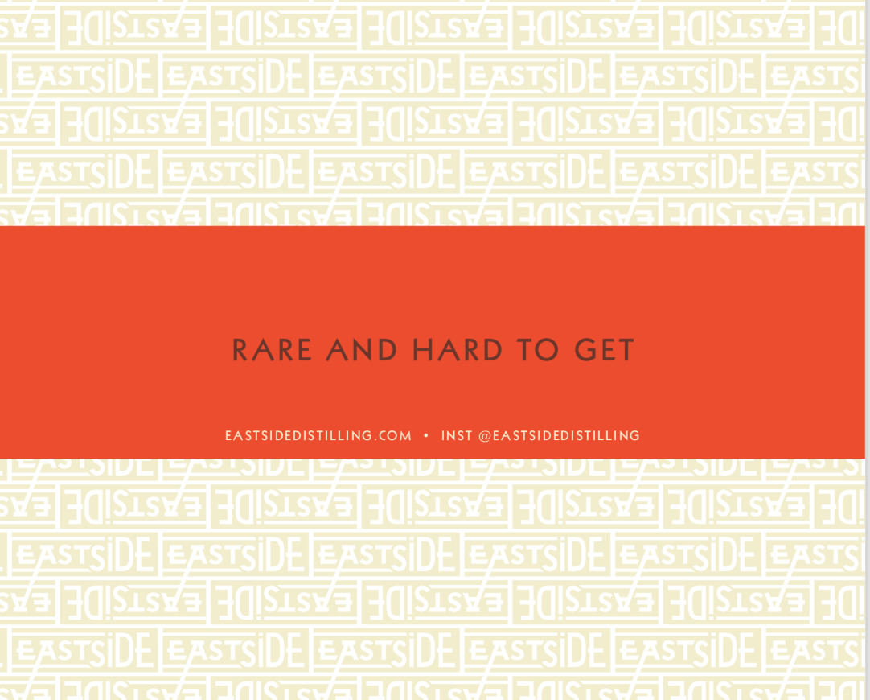
Notes:
PURPOSE: This is just the beginning—working on alignment and executing the 2021 plan
Focus on building a 3 year plan that capitalizes on huge opportunities
Key focus finish Balance Sheet Alignment
Key focus Stakeholder Alignment

